Slide 1

MACHINE LEARNING
Lý Lý Anh
Nguyễn Khắc Minh Luân

Slide 2
Multi-layer Neural Networks
Definition
A multi-layer neural network contains more than one layer of artificial neurons or nodes. They differ widely in design. It is important to note that while single-layer neural networks were useful early in the evolution of AI, the vast majority of networks used today have a multi-layer model.

Slide 3
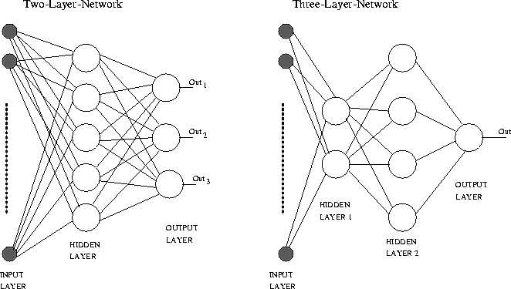
Example

Slide 4

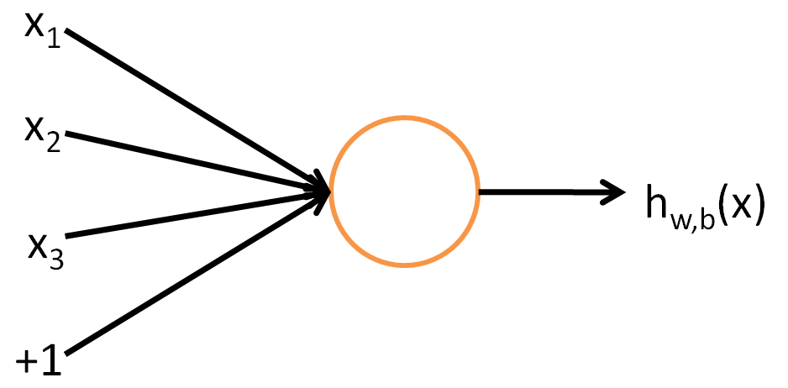
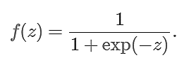
The sigmoid function:

Slide 5

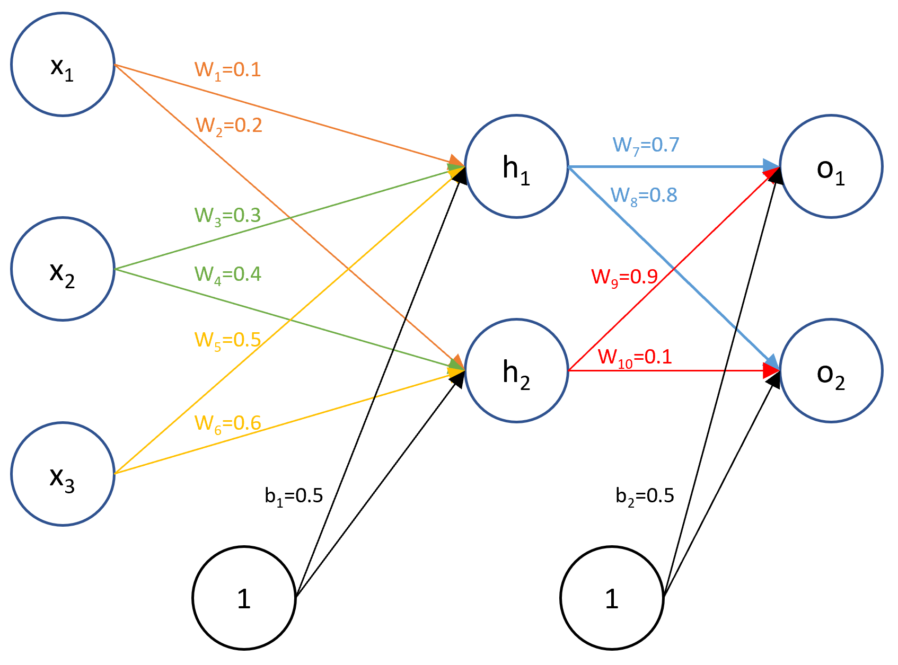
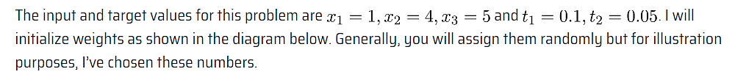
Initialize weights for the parameters we want to train:

Slide 6
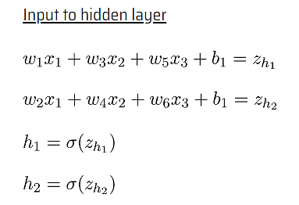
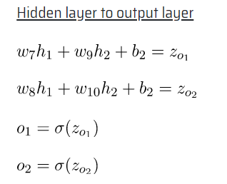
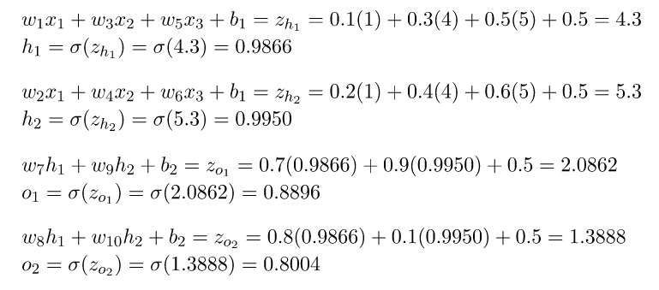

Slide 7
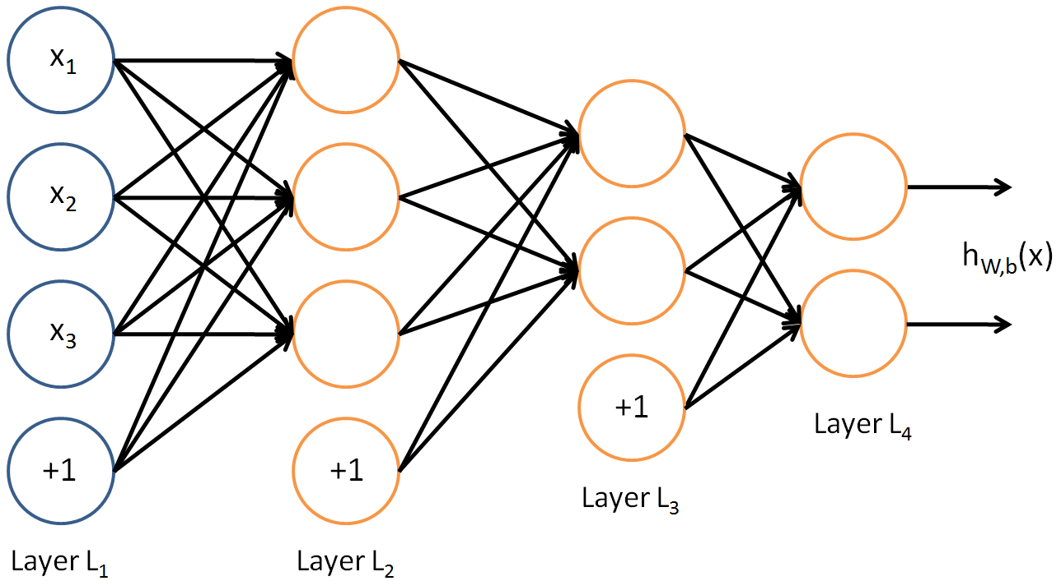
To train this network, we would need training examples (x^{(i)}, y^{(i)}) where y^{(i)}∈R². This sort of network is useful if there’re multiple outputs that you’re interested in predicting. (For example, in a medical diagnosis application, the vector x might give the input features of a patient, and the different outputs y_{i}’s might indicate presence or absence of different diseases.)

Slide 8
Back propagation algorithm
Definition
Backpropagation is a technique used to train certain classes of neural networks – it is essentially a principal that allows the machine learning program to adjust itself according to looking at its past function.

Slide 9
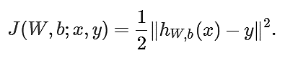
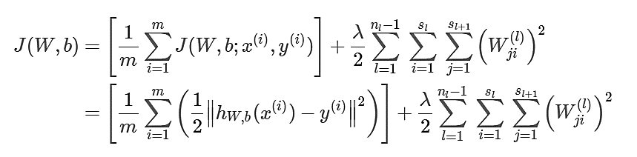
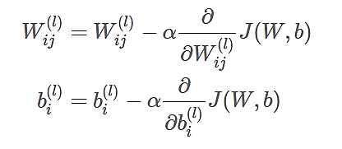
The loss function:
A training set of m examples, we then define the overall cost function to be:
Update:

Slide 10
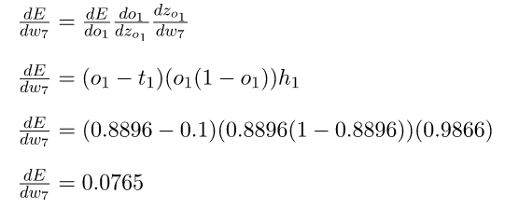

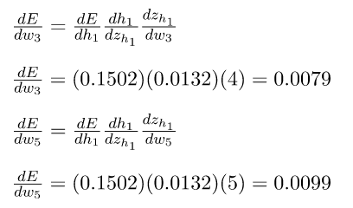
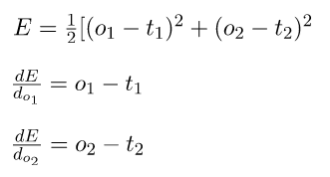
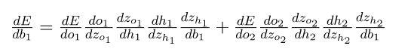
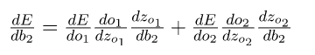
The backpropagation algorithm

Slide 11
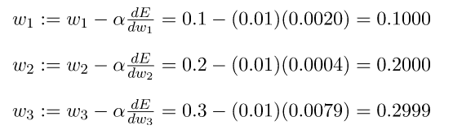
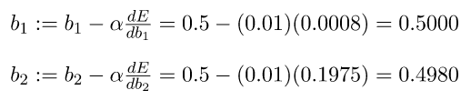
The backpropagation algorithm

Slide 12


